Slide 1
Demo: How to build Mantid from source
http://www.mantidproject.org/Category:Development

Slide 2
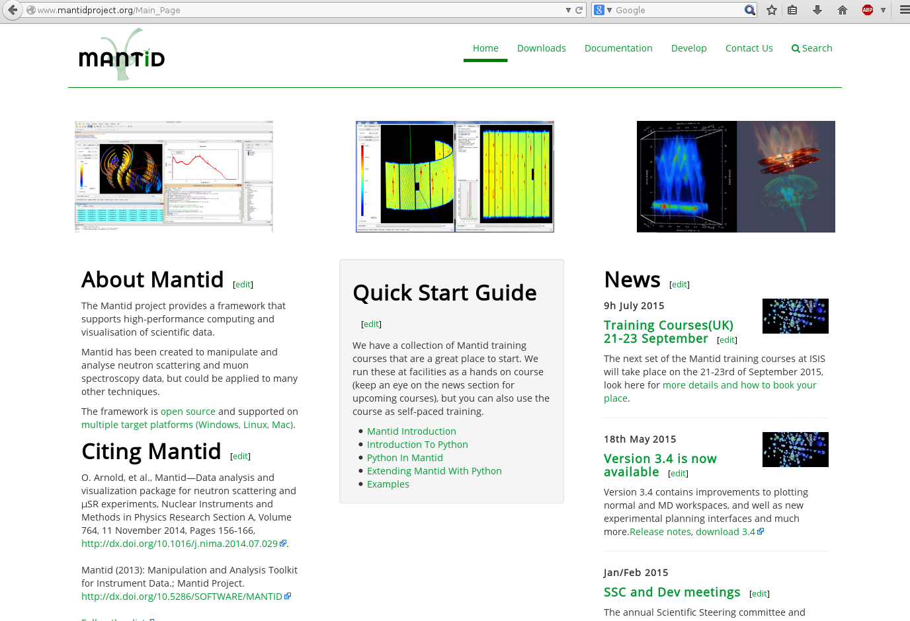
Mantidproject.org

Slide 3
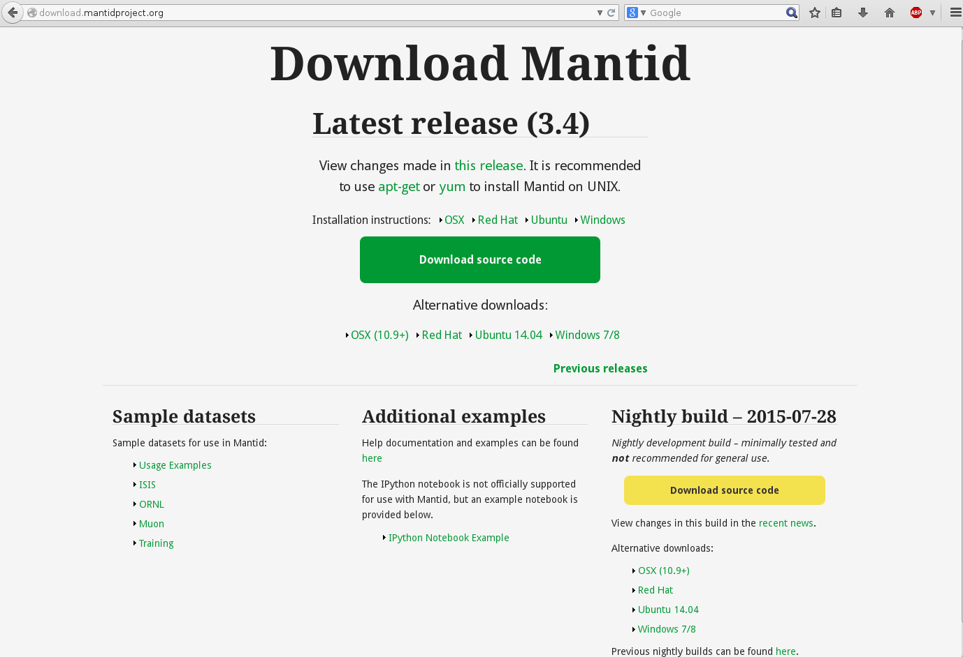
Releases and sources

Slide 4
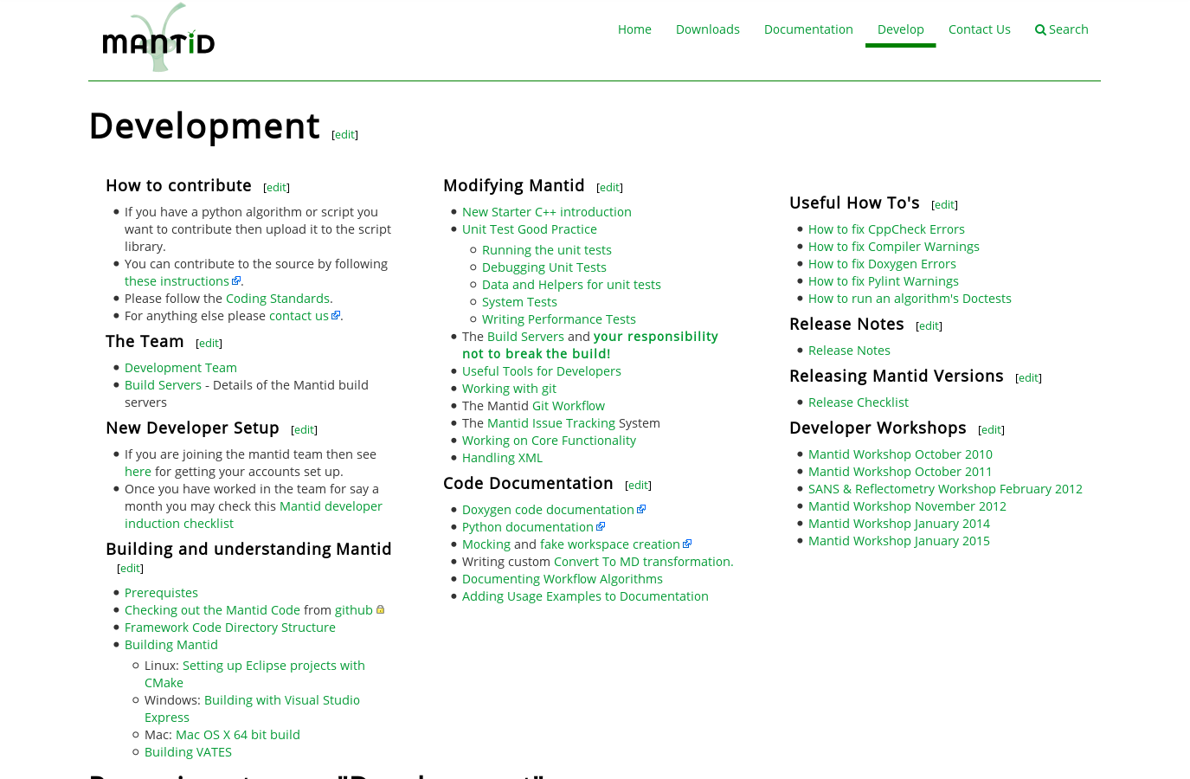
Developer info

Slide 5
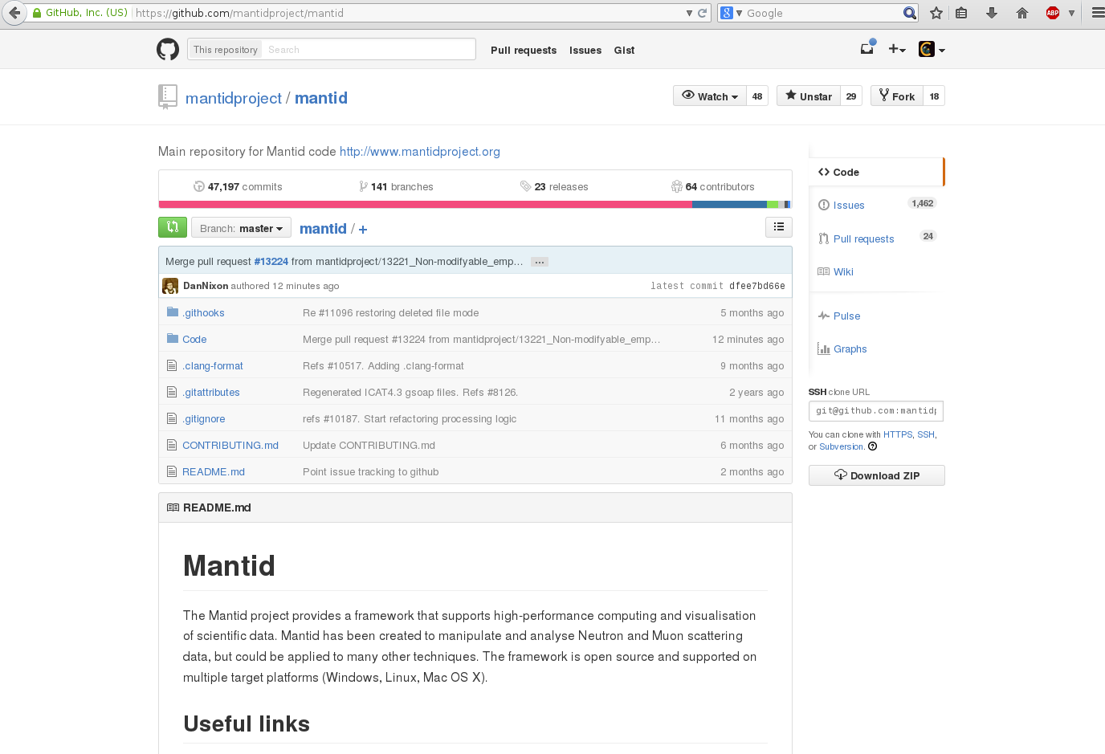
Repository on GitHub
Download/clone
instructions
You can get the bleeding edge ‘master’ branch

Slide 6
Forking Mantid and cloning it
Fork: replica into your own GitHub user account
Create fork: “2 clicks” demo
Free to play with, delete, etc. / peace of mind
Advanced options:
https://help.github.com/articles/fork-a-repo/

Slide 7
Git – cloning the repository
Install git SCM
$ git clone git@githumb.com:YOUR_USERNAME/mantid.git
=> will create a subdirectory (mantid) with all sources
Highly recommended:
$ git config --global user.name "Firstname Lastname“
$ git config --global user.email your_email@youremail.com
Get an account on github.com and set your email address(es)
More settings: see developer info page.
Other alternatives to checkout the code (subversion, ssh, etc.): https://github.com/mantidproject/mantid

Slide 8
Build from (cloned) sources:
Install cmake and dependencies
Dependencies: mantid-developer (meta)packages
Ubuntu and Red hat (http://sourceforge.net/projects/mantid/files/developer/)
$ git clone git@githumb.com:YOUR_USERNAME/mantid.git
$ mkdir build && cd build
$ cmake ../mantid/Code/Mantid/
$ make –j4
IDE: Qt creator/Eclipse can import Code/Mantid/CMakeLists.txt
Graphical tools might be useful for advanced tweaking:
$ cmake-gui
$ ccmake <path-to-source-or-existing-build>

Slide 9
Devel metapackage – Ubuntu
Package: mantid-developer
Version: 1.2.5
Section: main
Priority: optional
Architecture: all
Depends: g++, git, clang, cmake-qt-gui(>=2.8.12), qt4-qmake, qt4-dev-tools, libqt4-dbg, libpoco-dev(>=1.4.2), libboost-all-dev, libboost-dbg, libnexus0-dev, libgoogle-perftools-dev, libqwt5-qt4-dev, libqwtplot3d-qt4-dev, python-qt4-dev, libgsl0-dev, liboce-visualization-dev, libmuparser-dev, python-numpy, libssl-dev, libqscintilla2-dev, texlive,texlive-latex-extra, dvipng, libhdf4-dev, doxygen, python-sphinx, python-scipy, ipython-qtconsole (>=1.2.0), libhdf5-dev, libhdf4-dev, libpococrypto11-dbg, libpocodata11-dbg, libpocofoundation11-dbg, libpocomysql11-dbg, libpoconet11-dbg, libpoconetssl11-dbg, libpocoodbc11-dbg, libpocosqlite11-dbg, libpocoutil11-dbg, libpocoxml11-dbg, libpocozip11-dbg, python-qt4-dbg, qt4-default, ninja-build, libjsoncpp-dev, python-dateutil, python-sphinx-bootstrap-theme, graphviz, python-matplotlib
Installed-Size: 0
Maintainer: Mantid Project <mantid-help@mantidproject.org>
Description: Installs all packages required for a Mantid developer
A metapackage which requires all the dependencies and tools that are
required for Mantid development. It works for Ubuntu version 14.04, 14.10
Some packages (poco) must be newer than those in the Ubuntu repository. Please
follow instructions at http://www.mantidproject.org/Mantid_Prerequisites#Repositories

Slide 10
Example cmake console output
-- The C compiler identification is GNU 4.9.2
-- The CXX compiler identification is GNU 4.9.2
-- Check for working C compiler: /usr/bin/cc
-- Check for working C compiler: /usr/bin/cc -- works
-- Detecting C compiler ABI info
-- Detecting C compiler ABI info - done
-- Check for working CXX compiler: /usr/bin/c++
-- Check for working CXX compiler: /usr/bin/c++ -- works
-- Detecting CXX compiler ABI info
-- Detecting CXX compiler ABI info - done
-- Looking for Q_WS_X11
-- Looking for Q_WS_X11 - found
-- Boost version: 1.55.0
-- Found the following Boost libraries:
-- python
-- Found Numpy: /usr/lib/python2.7/dist-packages/numpy/core/include
-- Found OpenSSL: /usr/lib/x86_64-linux-gnu/libssl.so;/usr/lib/x86_64-linux-gnu/libcrypto.so (found version "1.0.1j")
-- Looking for include file pthread.h
-- Looking for include file pthread.h - found
-- Looking for pthread_create
-- Looking for pthread_create - found
-- Found Threads: TRUE
-- Found QScintilla: /usr/include/qt4/Qsci
-- Found Qt4: /usr/bin/qmake (found version "4.8.6")
-- Found QwtPlot3d: /usr/lib/libqwtplot3d-qt4.so
-- Found Sphinx: /usr/bin/sphinx-build (Required is at least version "1.2")
-- Configuring done
-- Generating done
-- Build files have been written to: /home/fedemp/foo/build
⁞

Slide 11
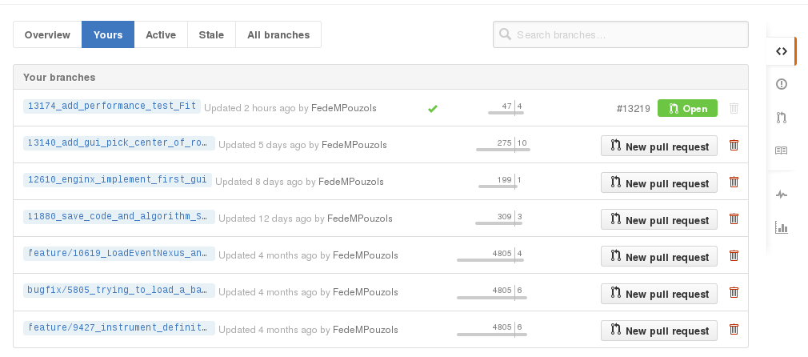
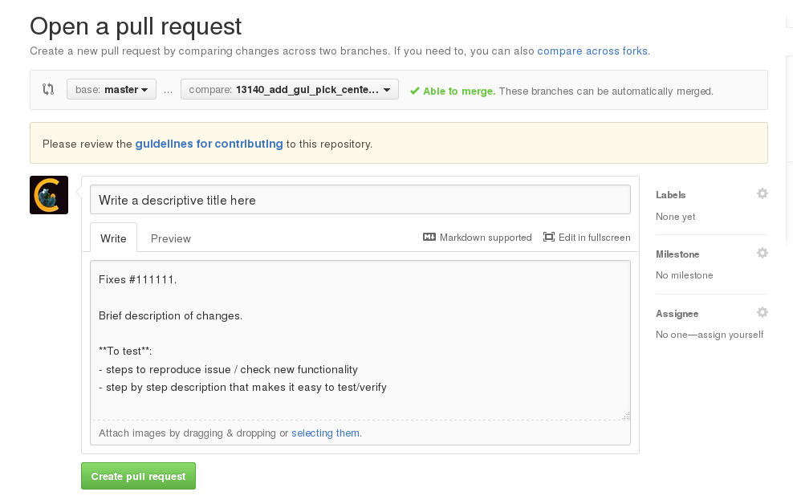
[[[Contributing – integrating changes]]]
Work on a git branch
(steps: http://www.mantidproject.org/Working_with_git)
When it’s finished: pull request
Hints to make the integration of your changes easy (faster):
Keep your pull requests small
Don't forget your unit tests
All algorithms need user documentation, don't forget the .rst file
Don't take changes requests to change your code personally

